Slide 1
Machine learning workflows for earth and environmental science
Analytical workflows for earth sciences: spring 2025
May 19-22

Slide 2
Learning objectives for the week
Understand when machine learning can be useful in earth and environmental sciences
Familiarity with basic concepts and vocabulary used in machine learning
Detailed understanding of and practical experience with machine learning workflows

Slide 3
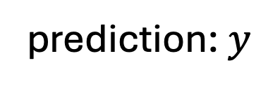
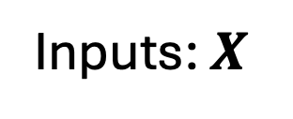
What is machine learning?
Machine learning is a catch all term for algorithms that take a set of inputs and make a prediction
Machine learning algorithm
Inputs: $X$
prediction: $y$

Slide 4
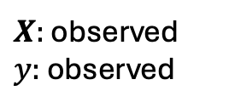
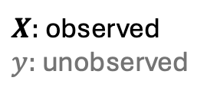
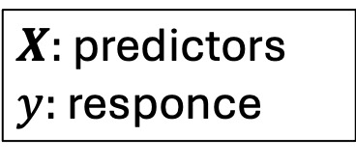


What is machine learning?
Machine learning algorithms are categorized by the tasks and data they are deigned for
Task
$X:$ observed
$y:$ unobserved
$X:$ observed
$y:$ observed
Unsupervised
Supervised
Clustering pixels in a satellite image into similar lane use types
$y:$ discrete
$y:$ continuous
Classification
Regression
$X:$ predictors
$y:$ responce
Identifying the species of animal in an image
Estimating the abundance of a species in a given location

Slide 5
What is machine learning?
Machine learning is part of the much larger field of Artificial intelligence
Random Forest
Machine learning
Neural network
AI
Large language models
Chat GPT

Slide 6
What are some examples of machine learning algorithms? (some examples)
Supervised
Unsupervised
Classification:
Logistic regression
generalized additive models (GAMs)
Random forest
Support vector machines
Neural networks
Regression
Linear regression
Ridge regression
generalized additive models (GAMs)
Random forest
Support vector machines
Neural networks
Principal component analysis
K- means clustering
Nonmetric multidimensional scaling
Autoencoder networks
Support vector machines
Random forest

Slide 7
Why use machine learning?
Capture complex relationships in high dimensional data sets
Nonlinear relationships
Interactions
Predictor 2 (high)
Response: y
Response: y
Predictor 2 (low)
Predictor: X
Predictor: X

Slide 8
Why use machine learning?
Capture complex relationships in high dimensional data sets
Process data set that are too large to manage with traditional statistical methods

Slide 9
Machine learning can be use for a wide range of problems in earth sciences
Species distribution models
Categorizing patterns of land use from satellite images
Weather prediction
Indirectly measurement from remote sensing data (e.g. atmospheric particulate matter)
Species identification from image and audio data

Slide 10
What are the problems with machine learning?
Interpretability
Machine learning algorithm are designed to recover patterns in data, but do not necessarily encode mechanisms.
See Wesselkamp et al. Ecology letters (2024) in this weeks reading for a counter example.

Slide 11
What are the problems with machine learning?
Interpretability
Over fitting
Response: y
Predictor: X

Slide 12
Bias variance trade-off
Best model
New data
Prediction accuracy
Training data
Model complexity

Slide 13
Two approaches to the bias variance tradeoff:
Internal complexity optimization: the algorithm is designed to adjust is complexity to the data automatically
Ensembles : Random Forest, Boosted Regression Trees
Deep learning
External complexity optimization: the complexity of the algorithm is adjusted by tuning hyperparameters with cross-validation.
Regularization: Ridge Regression, Artificial Neural Networks

Slide 14
Things to watch for in the examples
Training: running an algorithm that matching a model's predictions to data
Loss function: a metric used by the algorithm to match that patterns in the training data set and evaluate its performance
Regularization: A part of the algorithm that controls the complexity of the model’s predictions
Hyperparameters: pre-set numerical values that control the model’s behavior

Slide 15
Internal complexity optimization with ensembles
Create a collection of models that individual overfit the data and aggregate their predictions
Response: y
Predictor: X

Slide 16
Internal complexity optimization with ensembles
Create a collection of models that individual overfit the data and aggregate their predictions
Response: y
Predictor: X

Slide 17
Internal complexity optimization with ensembles
Create a collection of models that individual overfit the data and aggregate their predictions
Response: y
Predictor: X

Slide 18

Random forest and boosted regression trees
Ensembles of categorization and regression trees (CARTs)
True
0.4
True
X2 <0.5
True
0.1
Inputs:
X1
X3
Probability of an outcome
$$\{X1,X2,X3\}$$
False
0.01
False
0.005
False

Slide 19
CART algorithm
Input:
Y – vector of outcomes
X – Matrix of predictors
N – number of variables to test at each iteration
m – final group size
L – Metric to compare group splits.

Slide 20
CART algorithm
Input: Outcomes Y, predictors X, number of variables to try N, final group size m, Metric to compare group splits L.
Start with root node containing all outcomes in the data set
Search over N randomly chosen predictors X choose that splits the group to maximize the difference between the outcomes Y according to the metric L
Divide the data set base on the best splitting variable
Repeat steps 1 - 3 on the two new groups formed by splitting the root
Continue until each group has m observations in it.

Slide 21
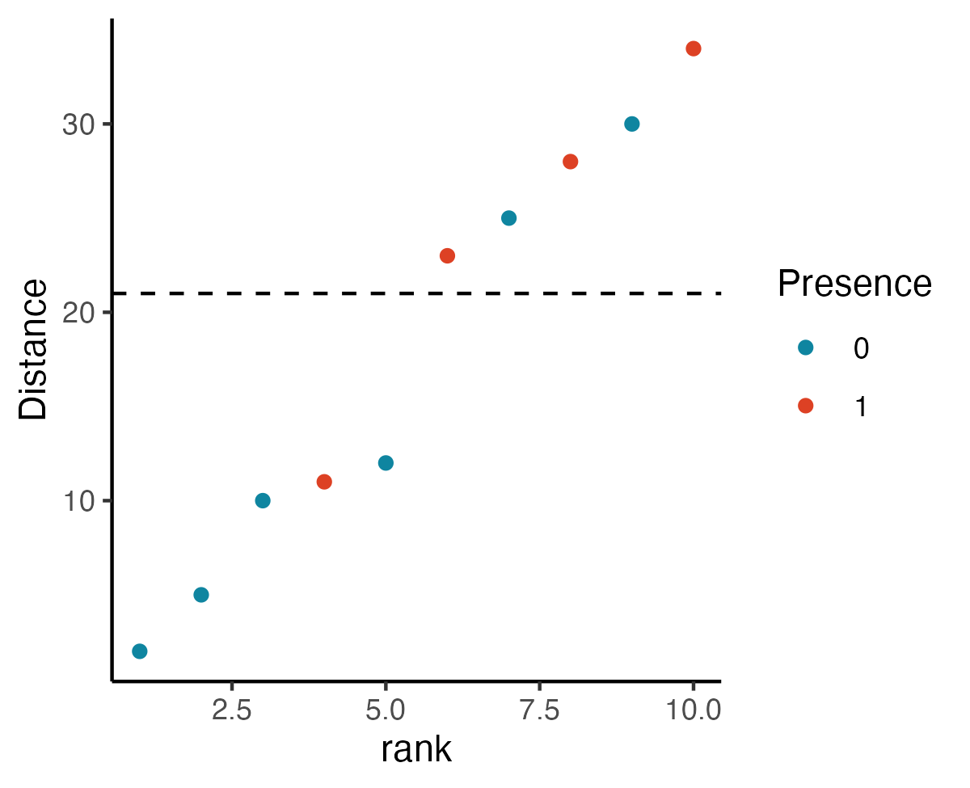
Example of a CART for categorization
Hypothetical data: presence of barred owls
Presence | Forested | Wilderness area | Distance from an urban center
0 | false | true | 24
0 | false | false | 3
0 | false | false | 5
0 | true | true | 28
0 | true | true | 30
0 | true | false | 10
1 | true | true | 28
1 | true | true | 23
1 | true | false | 11
1 | true | true | 34

Slide 22
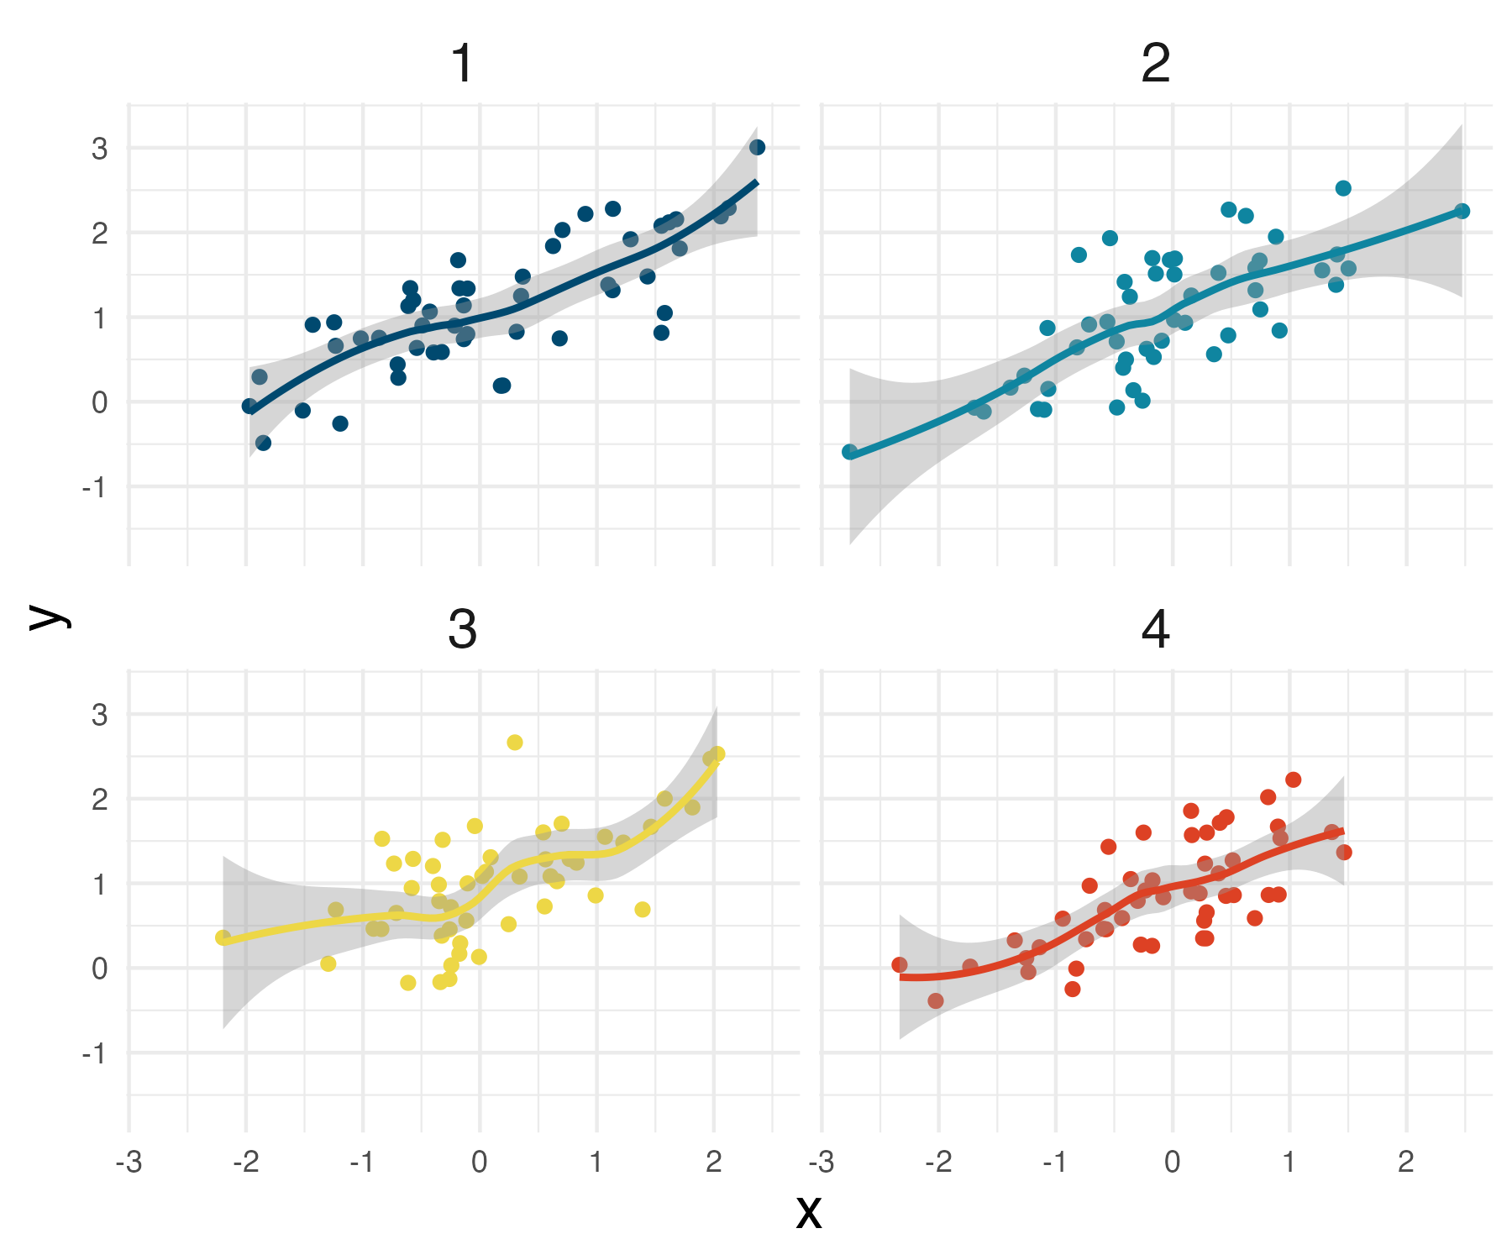

Individual CART models are quite flexible and can easily over fit a data set.
When a model over fits a data set it picks up patterns in the data sets that occurred only by chance
This is called sampling error
Ensemble of models with different sampling error will average to the correct solution
$$y=1+x+ε$$

Slide 23
Individual CART models are quite flexible and can easily over fit a data set.
How can we construct models with different sampling errors using only one data set?
$$y=1+x+ε$$

Slide 24
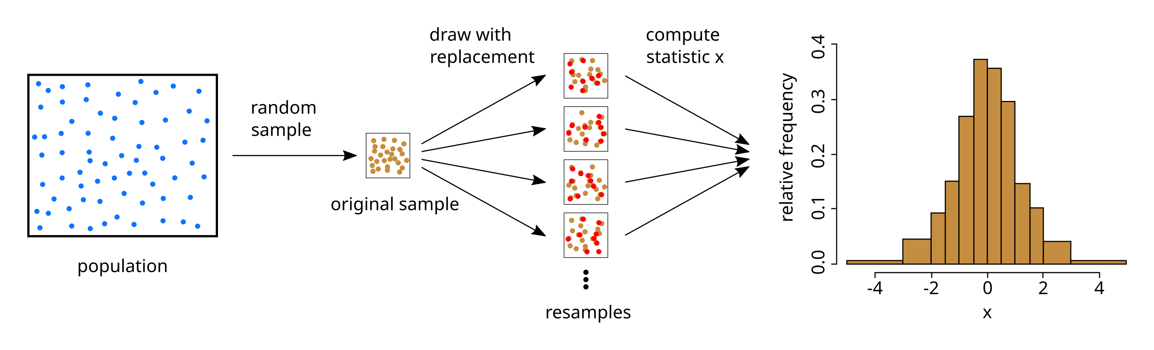
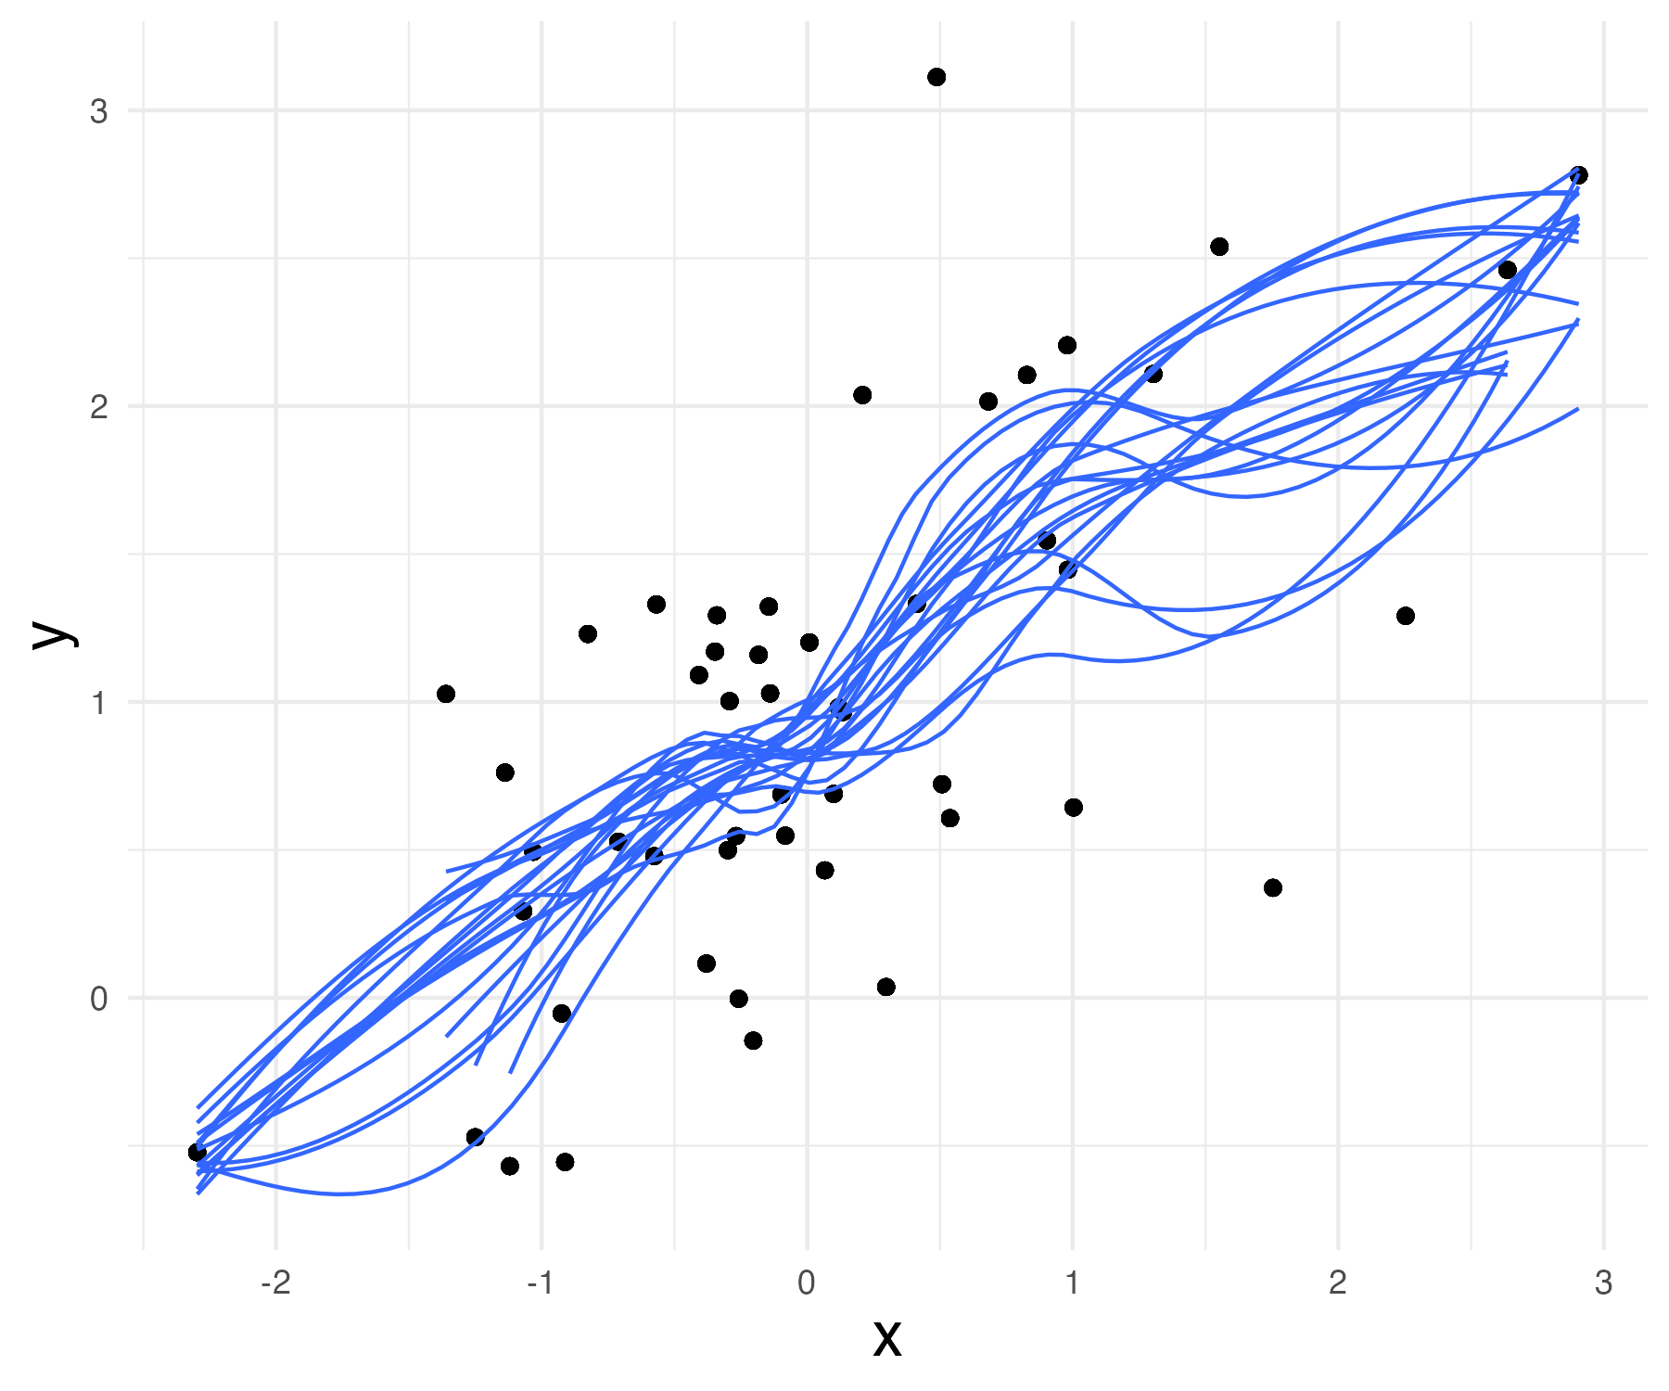
Random forest builds an ensemble of CARTs with bootstrapping
Bootstrap prediction
Ensemble prediction
https://en.wikipedia.org/wiki/Bootstrapping_(statistics)

Slide 25
Random forest builds an ensemble of CARTs with bootstrapping
Original data set
Resampled data set
Presence | Forested | Wilderness | Distance
0 | false | true | 25
0 | false | false | 2
0 | false | false | 12
0 | true | true | 5
0 | true | true | 30
0 | true | false | 10
1 | true | true | 28
1 | true | true | 23
1 | true | false | 11
1 | true | true | 34
Presence | Forested | Wilderness | Distance
0 | true | true | 5
0 | false | true | 25
1 | true | true | 34
0 | false | false | 12
1 | true | true | 34
… | true | false | 10
1 | true | true | 28
1 | true | true | 23
1 | true | false | 11
1 | true | true | 34

Slide 26
Random forests predict the outcome by majority voting for categorization and averaging for regression
Sample | X1 | X2 | X3
1 | False | False | True
X2
X3
X2
True
False
X3
False
X1
X2
X3
X1
True
False
Class 1
Class 2
Class 1
Class 2
Class 1
Class 2
Class 1
Class 2
Class 1
Class 1
Class 2
Tree 1 prediction: class 1
Tree 2 prediction: class 2
Tree 2 prediction: class 1
Forest prediction: class 1

Slide 27
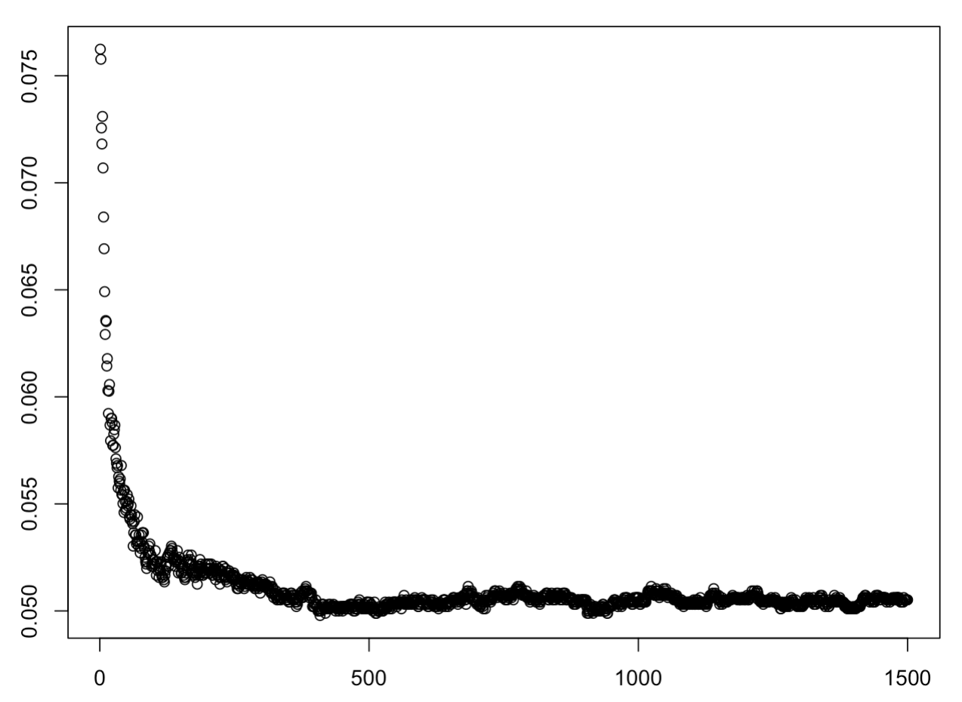
The model's ability to predict new data increases with the number of CARTS in the ensemble
Estimated error rate
Number of trees

Slide 28
Some advantages of random forests
Relatively simple and fast algorithm to implement with lots of easy-to-use implementations in R, Python and other languages
Typically requires minimal tuning to work well
Performs well on categorization and regression tasks
Produces an estimate of the model's accuracy
Interpretable:
Variable importances
Partial dependence plots

Slide 29
External complexity optimization:
The complexity of many machine learning models is determined by fixed parameters or other aspects of the models structure determined before it is trained on the data.
These parameters must be tuned to achieve, an optimal bias-variance trade off by estimating the model's performance on new data
Ridge regression and the closely related Lasso models provide useful examples

Slide 30
External complexity optimization:
Ridge regression and LASSO are extensions of multiple linear regression that are used when many predictors are available.

Slide 31
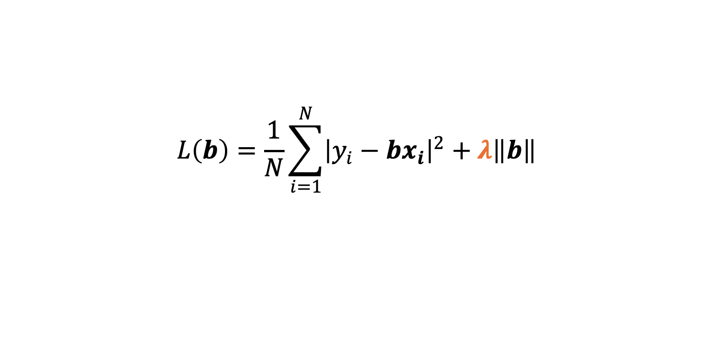
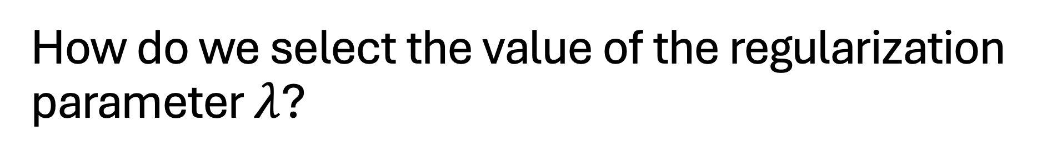
How do we select the value of the regularization parameter $λ$?
$$L\left(b\right)=\frac{1}{N}{\sum_{i=1}^{N}{{\left|y_{i}−bx_{i}\right|}^{2}+λ\left\|b\right\|}}_{ }$$

Slide 32
How do we select the value of the regularization parameter $λ$?
Optimize the bias-variance tradeoff:
Best model
New data
Prediction accuracy
Training data
Model complexity

Slide 33
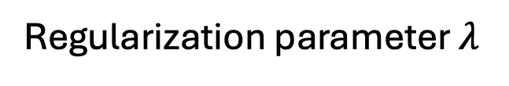
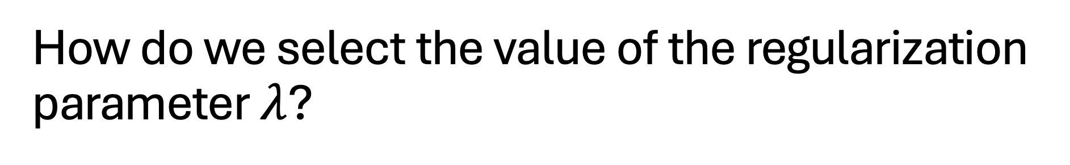
How do we select the value of the regularization parameter $λ$?
Optimize the bias-variance tradeoff:
Best model
New data
Prediction accuracy
Training data
Regularization parameter $λ$

Slide 34
How do we select the value of the regularization parameter $λ$?
How can we estimate the performance on new data (which we do not have?)
Optimize the bias-variance tradeoff:
Best model
New data
Prediction accuracy
Training data
Regularization parameter $λ$

Slide 35
Cross-validation:
Training data
Basic procedure:
Break the data set into a training and a testing set
Train the model on the training data
Calculate its performance on the testing data set
Repeat for each value of the regularization parameter and select the parameter with the best out of sample performance
Testing data

Slide 36
There are problems with the basic procedure:
If the testing set is small the estimate of the model's performance will be noisy
Solutions to problem 1 can make cross-validation computationally costly
If the procedure for splitting the data set does not reflect how new data will be collected the estimates will be biased.
Training data
Testing data

Slide 37
There are problems with the basic procedure:
Training data
What are some ways to increase the precision of our model performance estimates?
Testing data

Slide 38
K-fold cross-validation
Create multiple training and testing splits
Fit the model to each training data set and average the performance on the testing data sets

Slide 39
K-fold cross-validation
Retrain the model on each training and testing split
Full data set
Fold 1
Training
Training
Training
Training
Testing
Fold 2
Training
Training
Training
Testing
Training
Fold 3
Training
Training
Testing
Training
Training
Fold 4
Training
Testing
Training
Training
Training
Fold 5
Testing
Training
Training
Training
Training

Slide 40
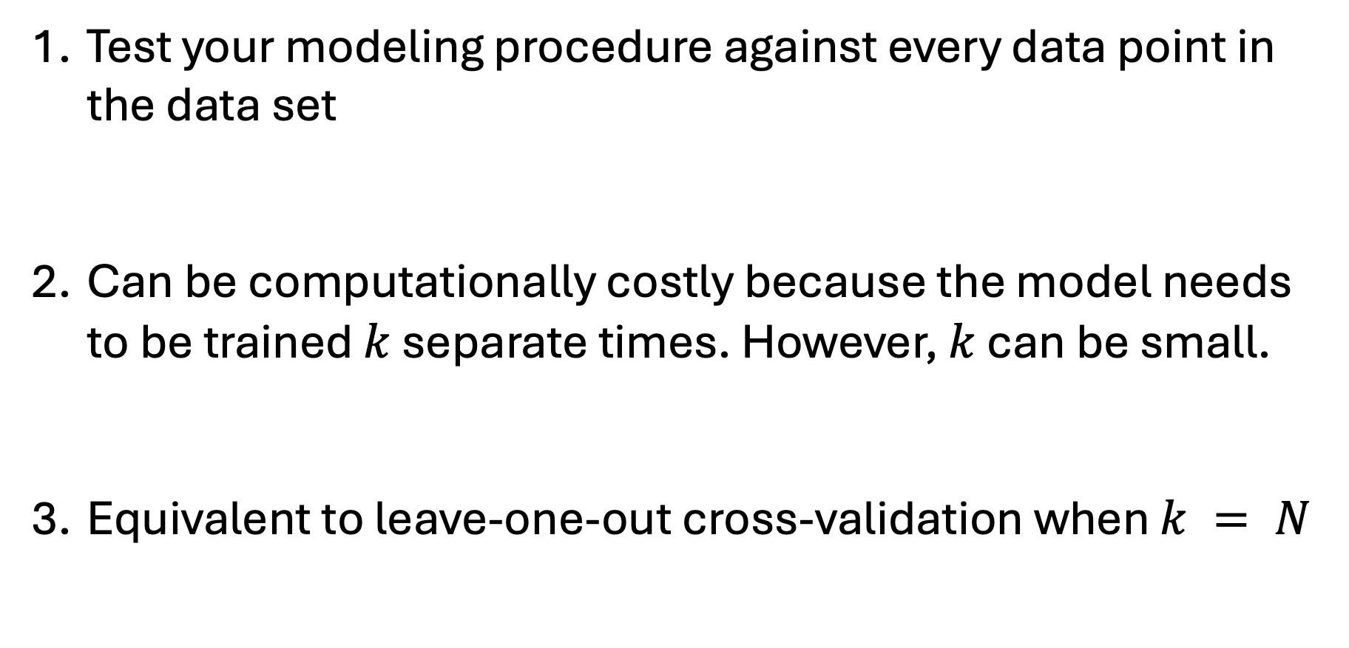
K-fold cross-validation
Test your modeling procedure against every data point in the data set
Can be computationally costly because the model needs to be trained $k$ separate times. However, $k$ can be small.
Equivalent to leave-one-out cross-validation when $k = N$

Slide 41

What can go wrong if we do not account for the structure of the data set?
The outcome y depends on two observed factors $X$ and an unobserved factor $U$
The variables $X_{2}$ and $U$have fixed values between groups of observations
$$y_{i,n}=X_{i,n}+X_{i}+U_{i}+ε_{i,n}$$
Site | y | X1 | X2 | U
1 | -0.29 | 0.2 | 0.51 | -1.0
1 | -1.49 | -1.0 | 0.51 | -1.0
1 | 0.01 | 0.5 | 0.51 | -1.0
2 | 1.8 | -0.5 | 1.2 | 1.1
2 | 2.4 | 0.1 | 1.2 | 1.1
2 | 3.3 | 1.0 | 1.2 | 1.1
…

Slide 42
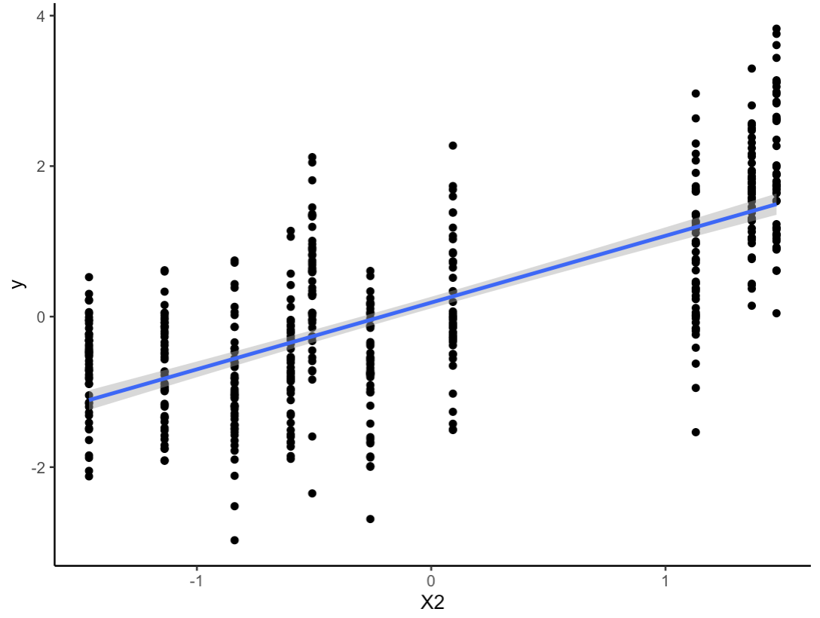
What can go wrong if we do not account for the structure of the data set?
$$y_{i,n}=X_{i,n}+X_{i}+U_{i}+ε_{i,n}$$
y
X2

Slide 43
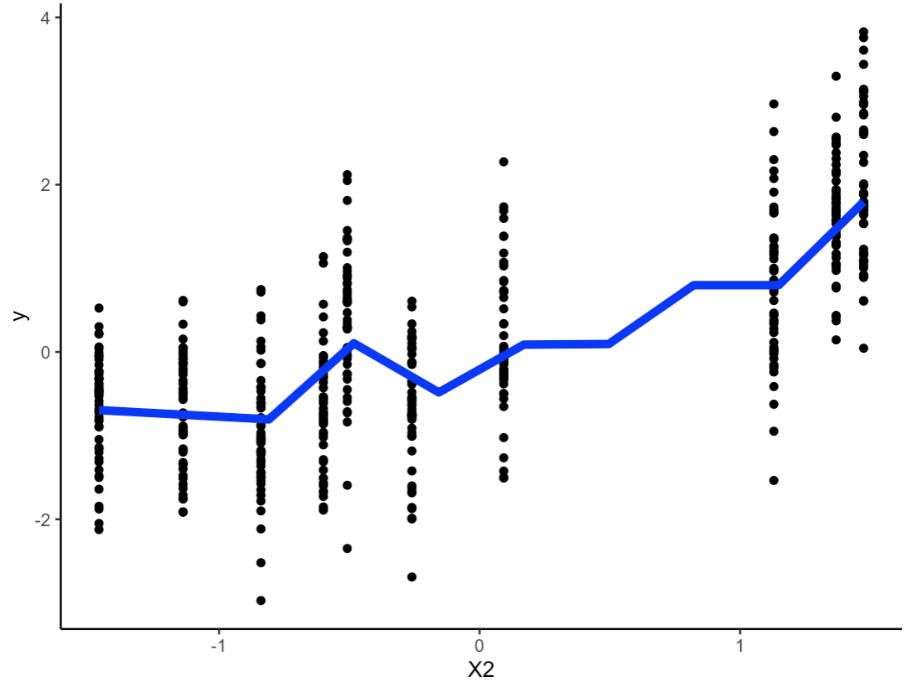
What can go wrong if we do not account for the structure of the data set?
Fit of a random forest model
Machine learning models can capture the effect of U by fitting nonlinear function to X2
RF compensates for large value of U in this group
y
X2

Slide 44
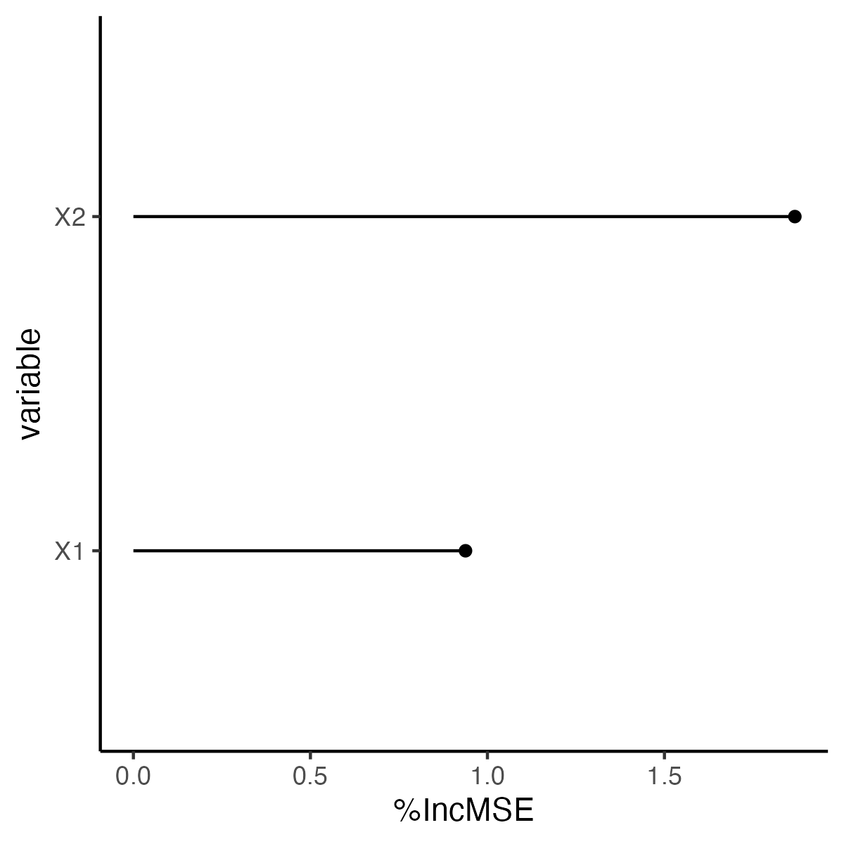
What can go wrong if we do not account for the structure of the data set?
Machine learning models can capture the effect of U by fitting nonlinear function to X2
Fitting the nonlinear function will cause the model to overestimate the explanatory power of X2
Over-estimates the predictive skill of the model on new sites
Variable
Variable importance

Slide 45
What can go wrong if we do not account for the structure of the data set?
Fit of a random forest model
Machine learning models can capture the effect of U by fitting nonlinear function to X2
Fitting the nonlinear function will cause the model to overestimate the explanatory power of X2
Over-estimates the predictive skill of the model on new sites
RF compensates for large value of U in this group
Data from a new site
X2

Slide 46
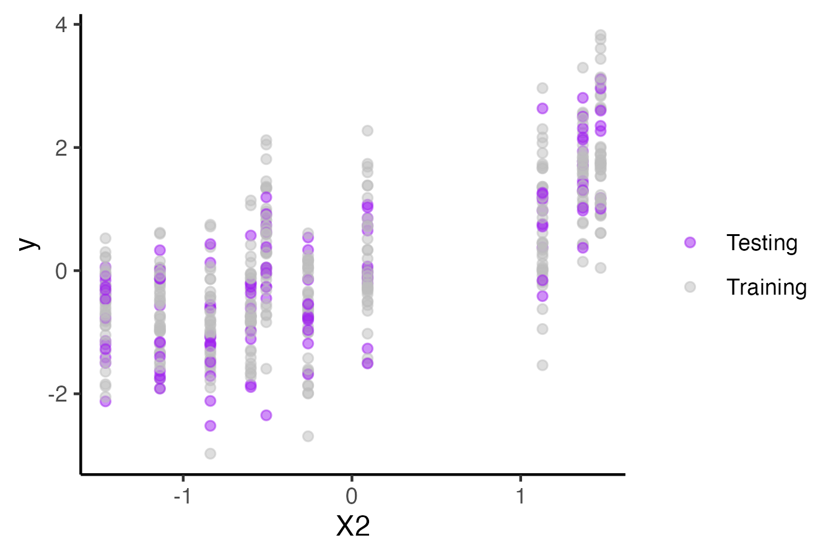
Using cross validation to account for group level structure
Random observations in testing splits

Slide 47
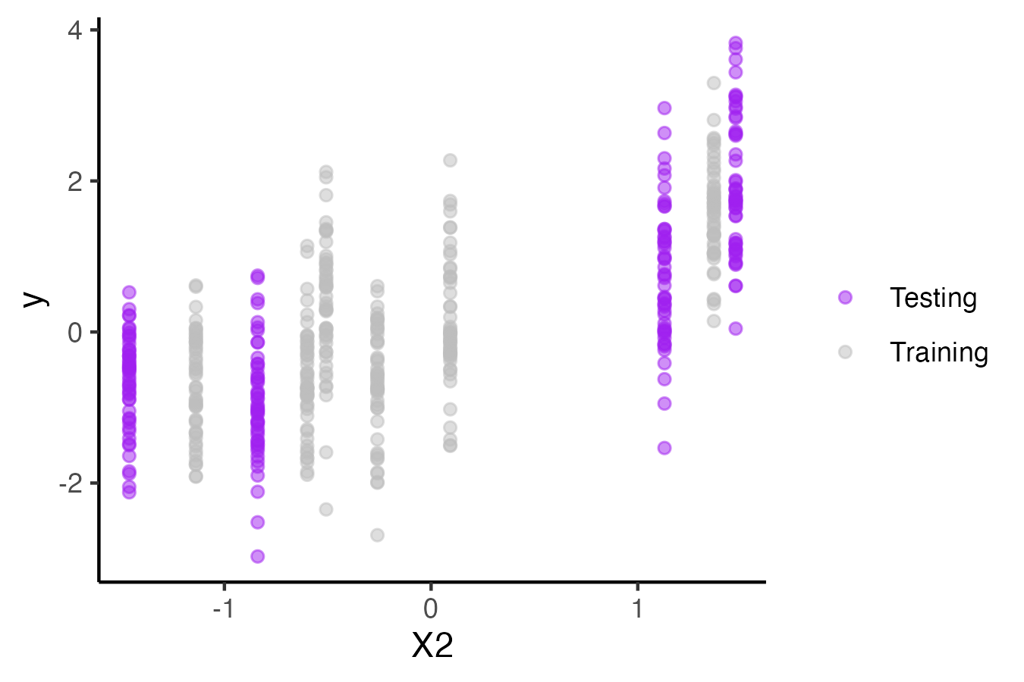
Using cross validation to account for group level structure
Random groups in testing splits

Slide 48
Using cross validation to account for group level structure
Would we ever not want to use testing and training splits that account for group level structure?

Slide 49
Using cross validation to account for group level structure
What it can do:
Improve our estimates of the model's predictive skill on new data
What it cannot do:
Reduces biased inferences made by model that do not account for structured data.

Slide 50
What are some other types of data where we need to be careful splitting testing and training sets?
Spatial structure
Temporal structure
Group structure
Hierarchical structure

Slide 51
Think pair share:
How might you divide up training data to account for temporal correlations?
Would you use a different approach for forecasting that you would for interpolating missing values?

Slide 52
Time series data: blocking
Training
Testing
Training
Training
Training
Training
Value
Time

Slide 53
Time series data: leave future out
Training
Training
Training
Testing
removed
removed
Value
Time

Slide 54
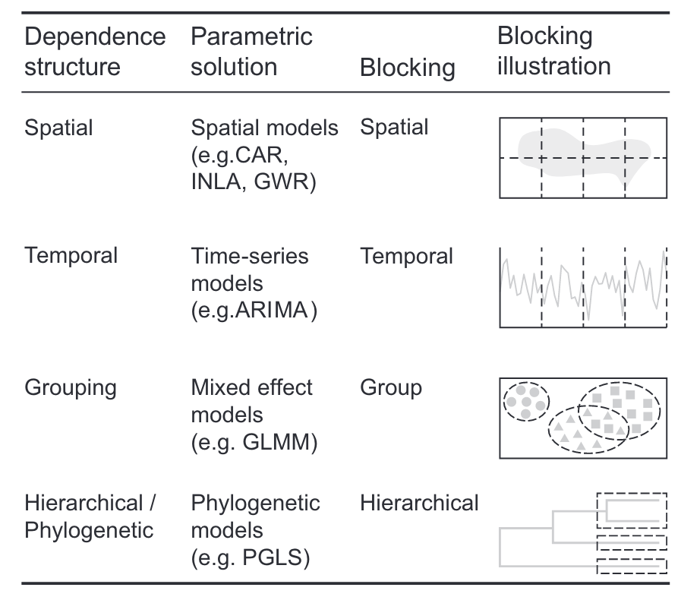
The way the data set is split between training and testing needs to match the data’s structure
Roberts et al. Ecogeography (2017)

Slide 55
Cross validation with and without extrapolation
Training
Training
Training
Training
Testing
removed
Value
Time
Testing data set is not well represented in training data!!

Slide 56
Cross validation with and without extrapolation
We may want to introduce extrapolations into cross validation for forecasting
Leave future out cross validation
Creating blocks based on the value of of predictors
Reducing extrapolation can improve interpolation
Use multiple blocks within each testing set
Algorithms that optimize distribution of predictors across blocks

Slide 57
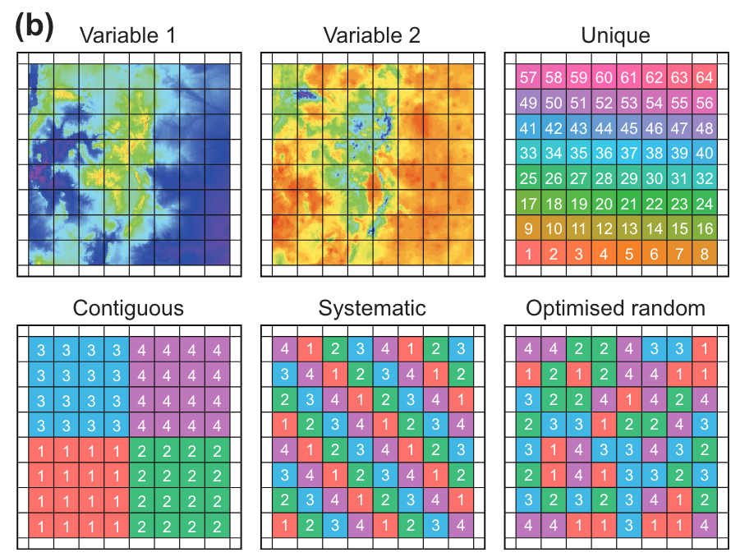
Cross validation with and without extrapolation
Which blocking techniques minimize extrapolation in the testing sets?
Roberts, D. R., et al. 2017. Cross‐validation strategies for data with temporal, spatial, hierarchical, or phylogenetic structure. Ecography 40:913–929.

Slide 58
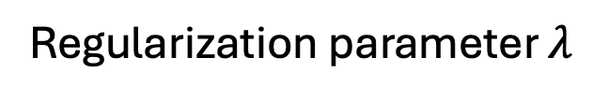
Cross validation is can be useful at multiple steps in the model build process
Parameter selection: Optimize the bias-variance tradeoff
Model validation: Estimate performance on new data
Best model
New data
Prediction accuracy
Training data
Regularization parameter $λ$

Slide 59
Two stage cross validation:
Full data set
Fold 1
Training
Training
Training
Testing
Fold 2
Training
Training
Testing
Training
Model tuning
Fold 3
Training
Testing
Training
Training
Fold 4
Testing
Training
Training
Training
Final training and validation
Fold 5
Training
Training
Training
Training
Validation

Slide 60
A basic machine learning workflow
Problem definition
Data collection and processing
Model development
Training
Model selection
Validation
Interpretation and deployment
Interpretability
Overfitting

